Slide 1
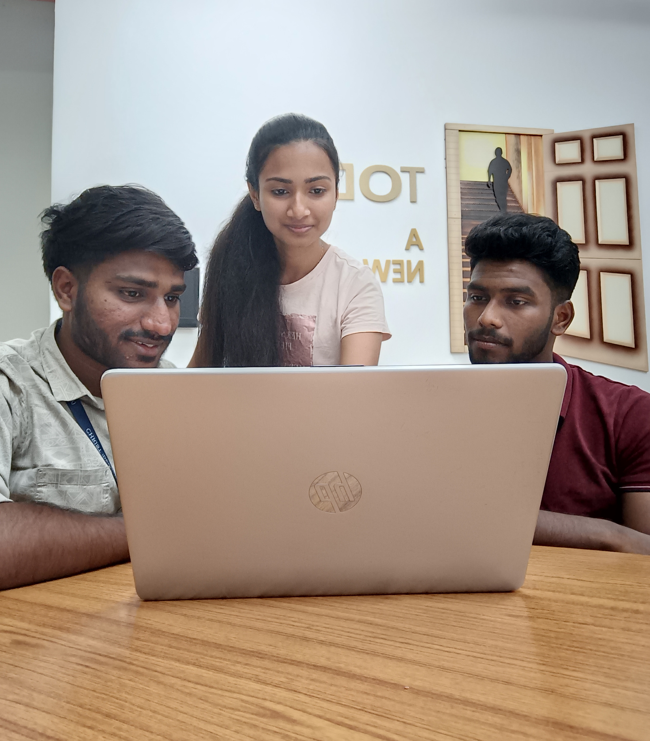

BAD VISION
FACE RECOGNITION APPLICATION USING JAVA
BY,
ANNU PUNNOOSE (2348011)
BHARANI KARTHICK(2348020)
DHILLIPKUMAR M(2348026)

Slide 2
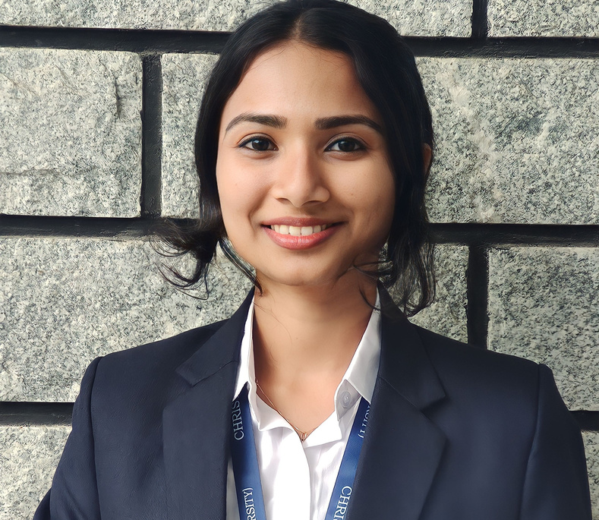


Meet The ‘BAD’ Group
FROM 3MDS,CHRIST(DEEMED TO BE UNIVERSITY)
ANNU PUNNOOSE
BHARANI KARTHICK
DHILLIPKUMAR M

Slide 3
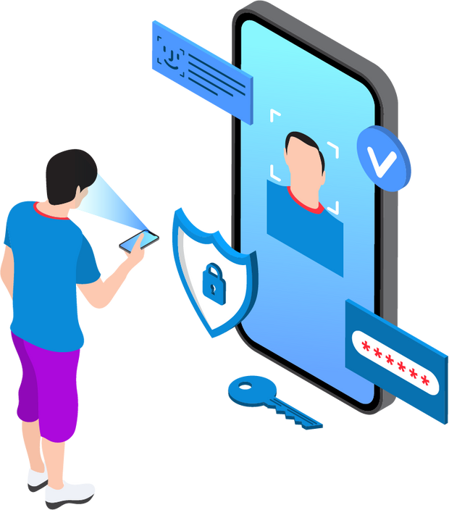
Project
Overview
This project focuses on developing a Java application for face recognition that overcomes challenges posed by uncooperative scenarios such as expressions, occlusions, and pose variations. The system aims to enhance accuracy and reliability by addressing these limitations. Key features include precise face capture and enrollment, passive liveness detection leveraging advanced 3D technology, protection against spoofing techniques, and real-time detection and response capabilities. By providing seamless operation, accurate representation of facial features, and robust security measures, the application seeks to improve the utility and reliability of face recognition technology across diverse applications.

Slide 4

MICROSOFT WINDOWS 10 (64-BIT)
JAVA DEVELOPMENT KIT (JDK) 8 INSTALLED AND SET IN SYSTEM ENVIRONMENT VARIABLES.
JAVA RUNTIME ENVIRONMENT (JRE) 6
ANDROID SDK
ANDROID STUDIO
ECLIPSE IDE FOR JAVA DEVELOPERS
ANDROID DEVELOPMENT TOOL KIT (ADT-KIT)
CONNECTED MOBILE DEVICE WITH LAPTOP FOR RUN AND TEST THE APPLICATION.
XML - FRONTEND
JAVA - BACKEND
OPEN-CV - FACE RECOGNITION
SOFTWARE REQUIREMENT

Slide 5




Features
With precise face capture and enrollment, it ensures accurate representation of facial features for seamless operation. Our passive liveness detection technology provides strong protection against fraudulent attempts, without disrupting user experience. Engineered to defend against various spoofing techniques like printed photos, video replays, masks, and deepfakes, our solution reliably detects and rejects fraudulent attempts. Real-time detection and response capabilities provide immediate feedback on facial input liveness, swiftly identifying and mitigating spoofing attempts to reduce unauthorized access.
Face Capture & Enrollment
Liveness Detection
Anti Spoofing
Real-time Detection

Slide 6
How our App is different?
1.Precision and Efficiency in Face Capture and Enrollment: Ensures accurate representation of facial features with seamless operation
2.Customizable Threshold Settings: Allows users to set thresholds for parameters
3.Addressing Uncooperative Scenarios: Overcomes challenges posed by varying expressions, occlusions, and pose variations (< 60 degrees), optimized for mobile environments

Slide 7
Testing Process
and Results

Slide 8
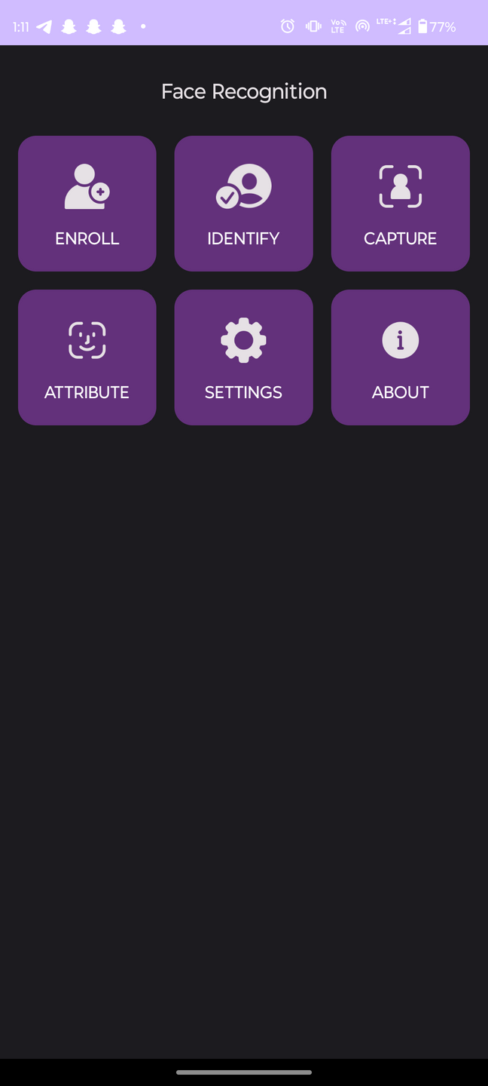

APPLICATIONDASHBOARD

Slide 9
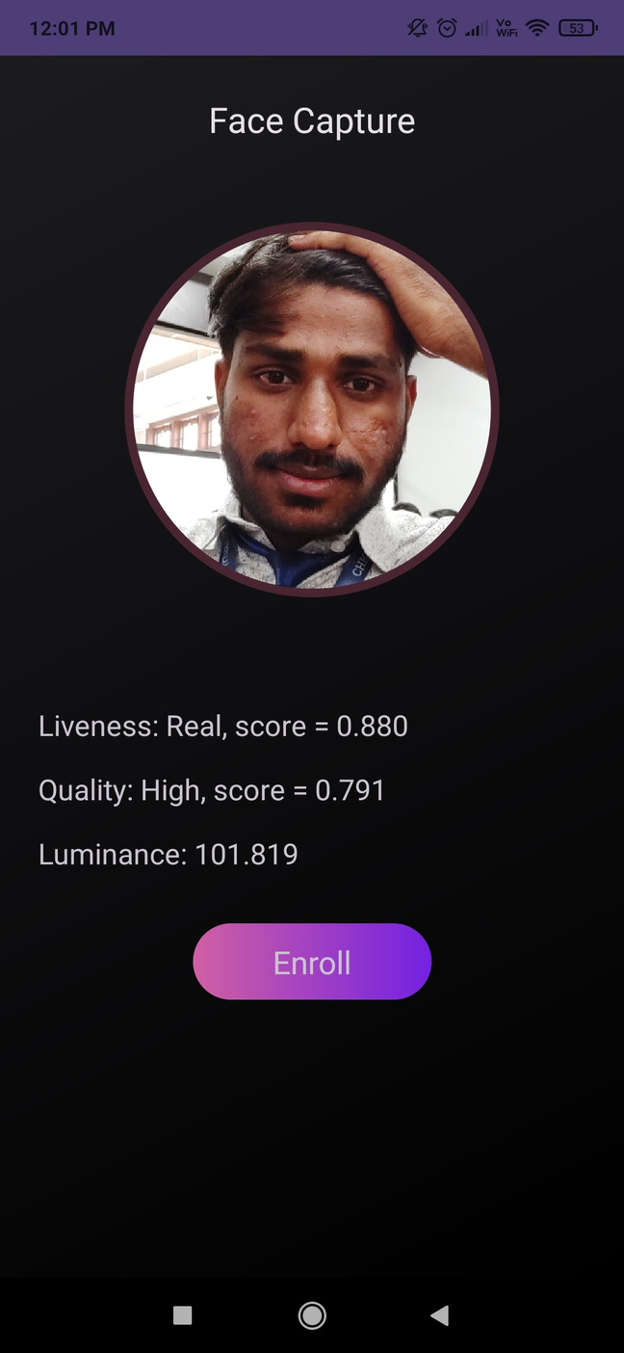
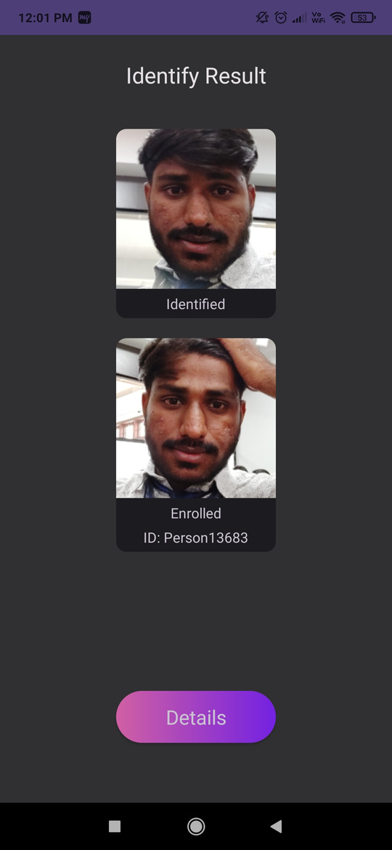
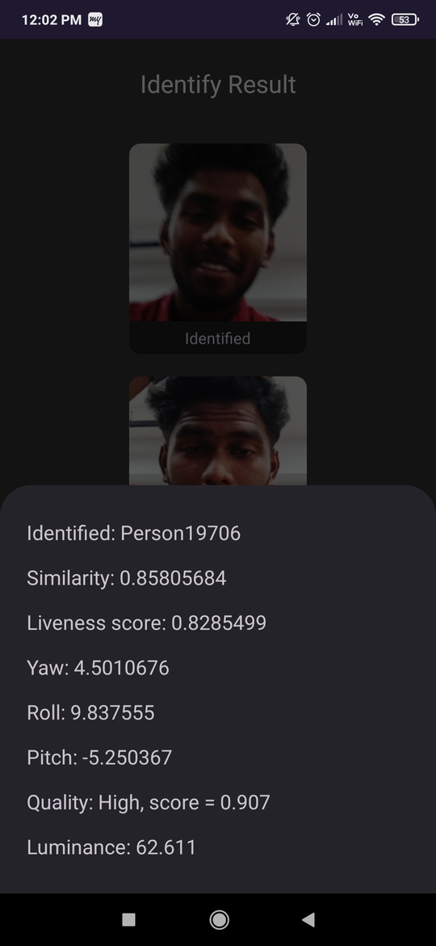
Face Capture & enrollment
Our solution excels in capturing and enrolling faces with precision and efficiency. This app’s solution ensures seamless operation and accurate representation of facial features.

Slide 10
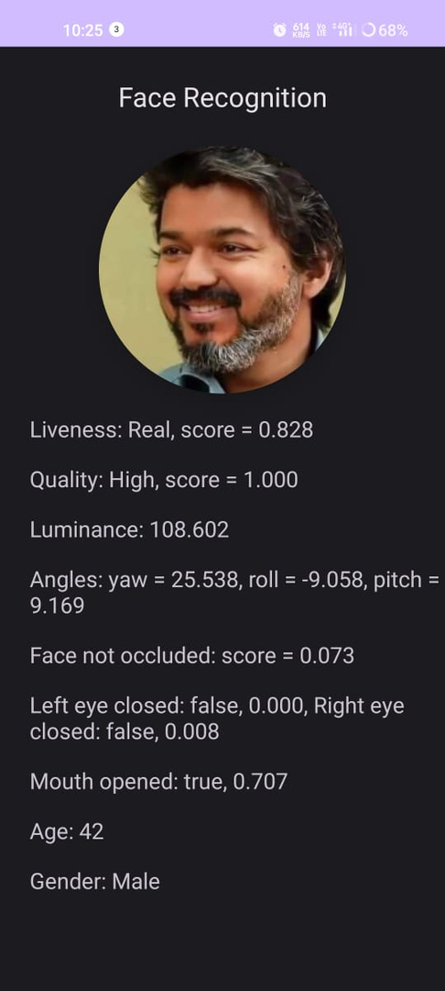

Real-Time Detection
Our SDK provides real-time detection and response capabilities, offering immediate feedback on the liveness of facial inputs during the authentication process.

Slide 11
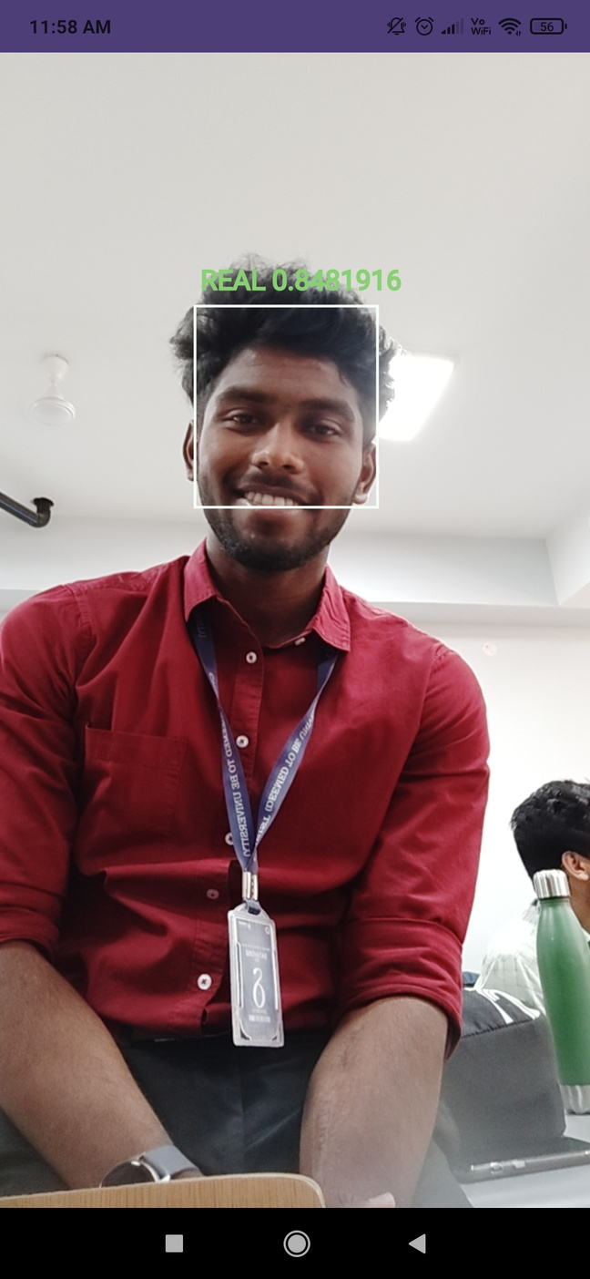
Liveness Detection
Unlike traditional methods that rely on user interaction, such as blinking or smiling, our SDK operates passively, seamlessly integrating into authentication processes without disrupting the user experience. This passive approach enhances security while ensuring a frictionless authentication process for users.

Slide 12
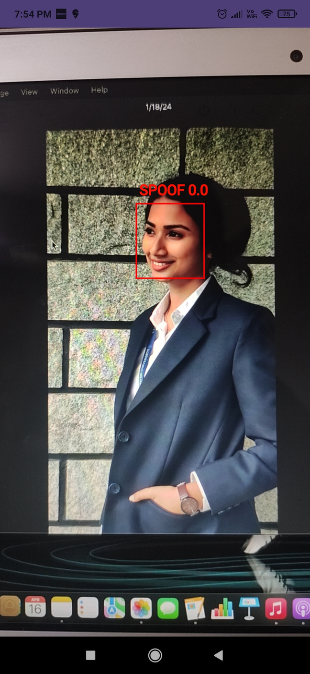
Anti Spoofing Techniques
Our SDK is engineered to defend against a wide range of spoofing techniques. Whether it’s a printed photo, a video replay, a 3D mask, or a sophisticated deepfake, our solution can reliably detect and reject fraudulent attempts, safeguarding the integrity of facial recognition systems.

Slide 13

Limitations
No multiple face detection.
Limited to On-Premise
No Enrollment of faces with the user name.

Slide 14
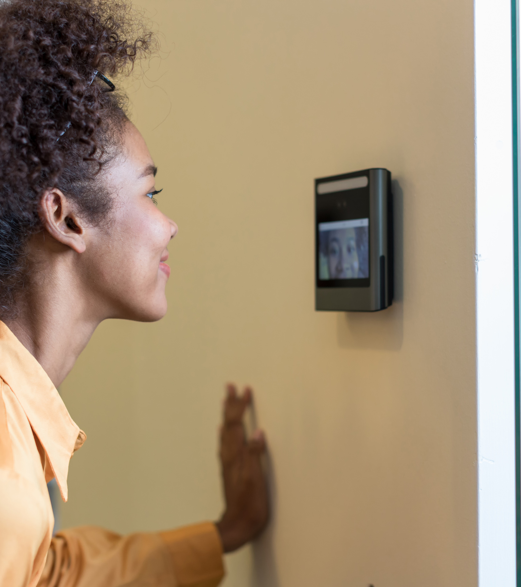
Futute Recommendation
Attendance Systems
We can expand the application's use in attendance systems beyond traditional workplaces to include educational institutions, events, and conferences. Integration with scheduling and calendar apps can automate attendance tracking further.

Slide 15

Conclusion
This project successfully developed a Java-based face recognition system that addresses the limitations of existing approaches in handling expression variations, occlusions, and pose variations. The system demonstrated high recognition accuracy and reliability, paving the way for its deployment in diverse real-world applications.

Slide 16


